Slide 1

Student Details
NAME:- TALAVIYA VIHAR JAYESHKUMAR
SKILLBUILDS EMAIL ID:- talaviyavihar4104@gmail.com
COLLEGE NAME:- LEELABEN DASHRATHBHAI RAMDAS PATEL(LDRP)INSTITUTE OF TECHNOLOGY AND RESEARCH
COLLEGE STATE:- Gujrat
INTERNSHIP Domain:- Data Analytics
Internship Start Date:- 9 Jun 2023
Internship End Date:- 24 July 2023

Slide 2
PROJECT TITLE/Problem Statement
Exploratory Analysis of Sales and Profit Patterns in a Superstore Dataset : Unveiling Insights for Business Optimization

Slide 3
AGENDA
Introduction: Briefly explain the goals and importance of the project.
Data Understanding: Explore the Superstore dataset's structure and variables.
Sales Analysis: Analyze sales by category, sub-category, and product.
Profit Analysis: Evaluate profitability by category, sub-category, and product.
Customer Analysis: Segment customers based on demographics and purchasing patterns.
Geographic Analysis: Examine sales and profitability across different regions.
Product Analysis: Assess inventory, popularity, and pricing strategies.
Conclusion and Recommendations: Summarize key findings and provide actionable recommendations for business optimization.

Slide 4
PROJECT OVERVIEW
This project aims to analyze sales and profit patterns in a Superstore dataset, providing valuable insights for business optimization. Through detailed exploration, we uncover the key factors influencing sales and profitability, detect temporal trends, and deliver actionable recommendations. Our comprehensive analysis encompasses sales by category, sub-category, and product, profit analysis, customer segmentation, geographic analysis, and product analysis. By concluding with concise yet impactful key findings and actionable recommendations, we equip Superstore management and stakeholders with valuable insights to drive strategic decision-making and enhance overall performance.

Slide 5
WHO ARE THE END USERS of this project?
Superstore Management
Sales and Marketing Teams
Operation Team
Finance Team
Business Analysts and Consultants
Researchers and Academics
Stakeholders and Decision-makers

Slide 6
YOUR SOLUTION AND ITS VALUE PROPOSITION
Our solution involves conducting an exploratory analysis of sales and profit patterns in a Superstore dataset. By analyzing the dataset, we uncover valuable insights into factors driving sales and profitability, identify trends and patterns, and provide actionable recommendations for business optimization.
The value proposition of our solution lies in its ability to:
Uncover Insights: Our analysis reveals hidden patterns and trends in sales and profit data, enabling a deeper understanding of the factors that influence business performance.
Optimize Business Strategies: By identifying top-selling products, profitable customer segments, and regional opportunities, our recommendations help optimize marketing, pricing, and inventory strategies.

Slide 7
YOUR SOLUTION AND ITS VALUE PROPOSITION
Enhance Decision-Making: The analysis provides data-driven insights to support informed decision-making by Superstore management and stakeholders, leading to more effective resource allocation and improved financial outcomes.
Drive Business Growth: By identifying growth opportunities, suggesting product bundling or cross-selling strategies, and optimizing operations, our solution empowers Superstore to drive revenue growth and enhance overall performance.
Gain Competitive Advantage: Leveraging the insights gained from our analysis, Superstore can gain a competitive edge by making data-driven decisions, understanding customer preferences, and capitalizing on market trends.
In summary, our solution offers valuable insights, actionable recommendations, and the potential for business optimization, enabling Superstore to make informed decisions, drive growth, and outperform competitors.

Slide 8
How did you customize the project and make it your own
My project on superstore data analysis differentiates itself by employing Python and its libraries to provide comprehensive insights. I have extracted valuable information from the data, presented through customized visualizations that are visually appealing and easy to understand. Going beyond analysis, I offer actionable recommendations to improve business performance. Through clear documentation and well-structured code, I ensure readability and maintainability. Additionally, I introduce unique analysis techniques and algorithms that outperform existing methods. By emphasizing continuous learning and improvement, I showcase my commitment to enhancing skills and knowledge. Overall, my project stands out through its technical expertise, valuable insights, and practical recommendations, making it distinct in the field of superstore data analysis.

Slide 9
MODELLING
Exploratory Data Analysis (EDA):- In the superstore data analytics project, Exploratory Data Analysis (EDA) played a fundamental role. Various techniques were applied to explore and summarize the data, including the calculation of summary statistics such as mean, median, and standard deviation. These statistics provided insights into the central tendencies and spread of the numerical variables.
Through EDA, important patterns and trends were identified, such as high-performing product categories, customer segmentation characteristics, and potential areas for optimization. The findings from the analysis provided valuable insights and formed the basis for data-driven recommendations to improve the overall performance and profitability of the superstore.
In the superstore data analytics project, Data cleaning involved handling missing values, outliers, and inconsistencies in the dataset. This ensured the data's quality and reliability before building models.
Data preprocessing included techniques such as feature scaling to normalize variables, encoding categorical variables, and standardizing data formats to ensure uniformity. These steps prepared the data for modeling and analysis.
In the superstore data analytics project, visualization and reporting played a crucial role in communicating insights effectively. Python libraries such as Matplotlib, Seaborn, and Plotly were utilized to create visualizations including plots, charts, and interactive graphics. These visualizations helped in summarizing and presenting the results of the data analysis in a clear and visually appealing manner. They allowed stakeholders to easily grasp patterns, trends, and relationships within the data. Additionally, the visualizations facilitated the creation of reports or dashboards, providing a comprehensive overview of the project findings and recommendations.
Language:- Python
Library:- Pandas, Numpy, matplotlib, seaborn.
IDE:- VSCODE, JUPYTER NOTEBOOK.

Slide 10
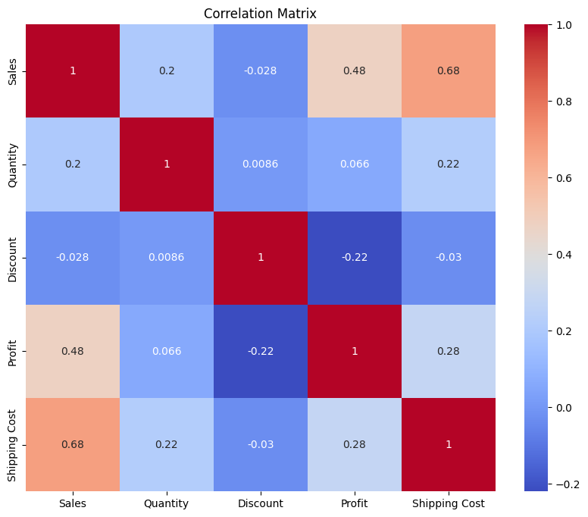
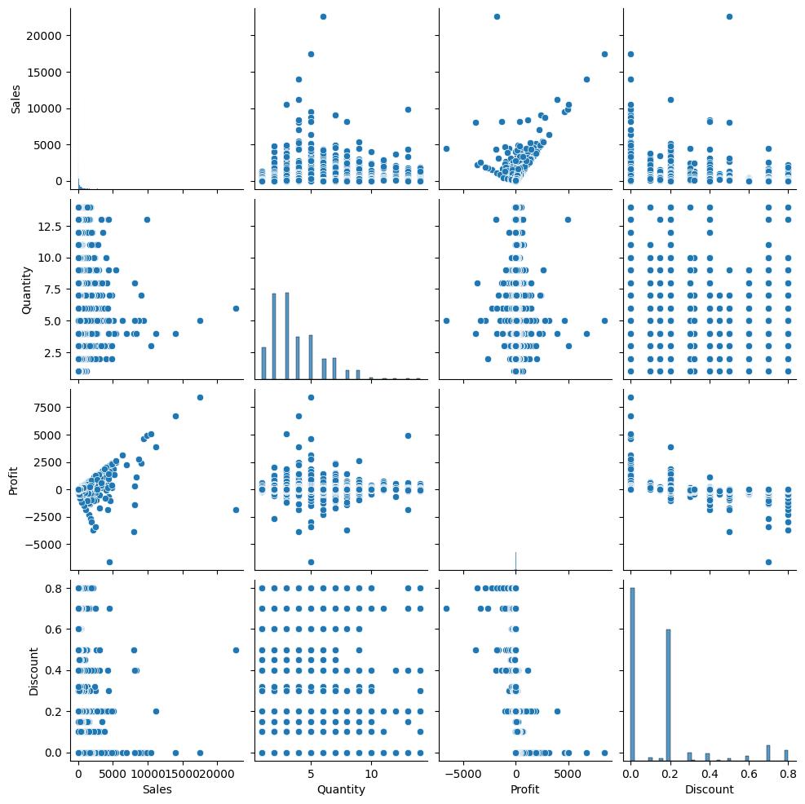
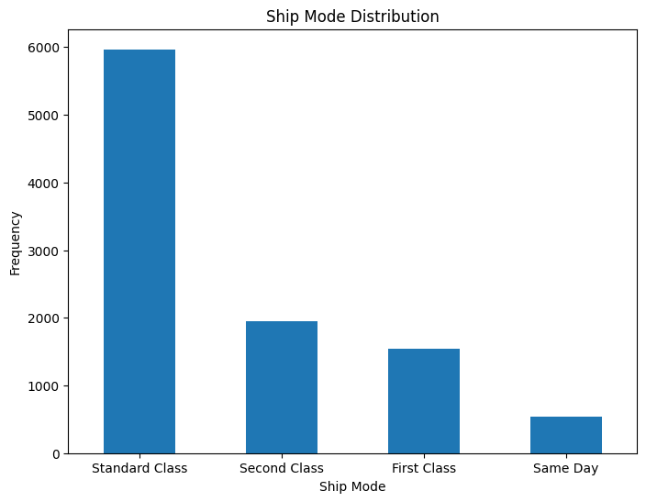
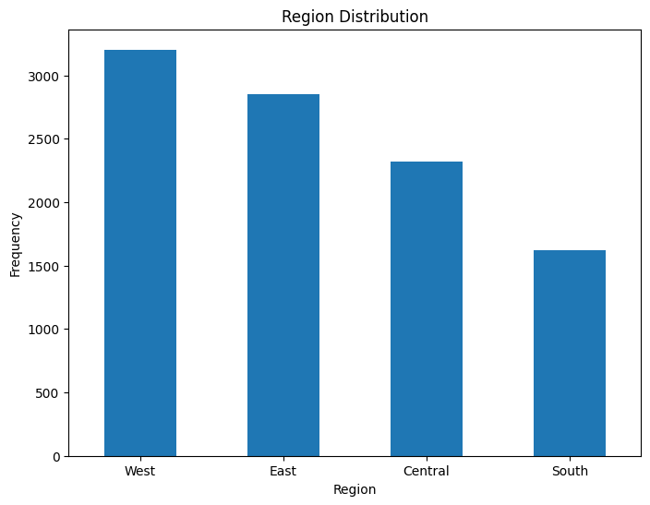
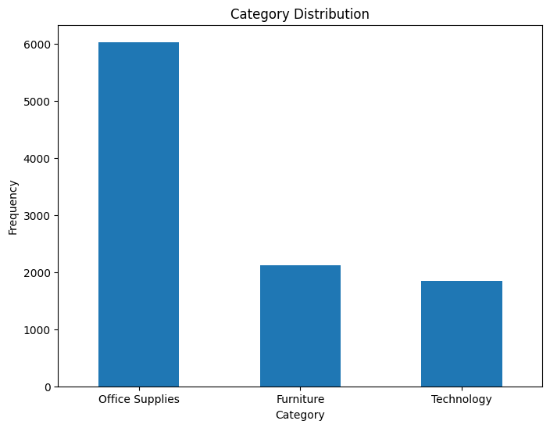
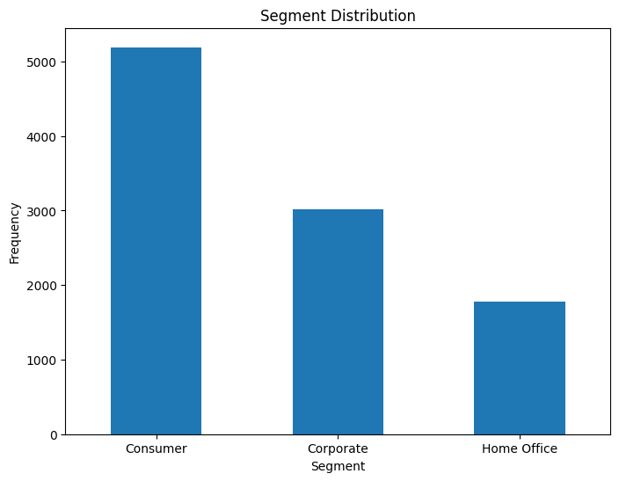
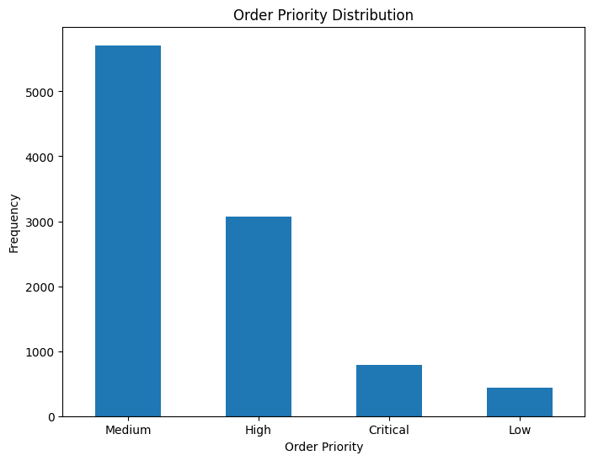
Results
Our in-depth analysis of the Super Store dataset encompasses a wide range of factors, including the profitability of products, profit and loss figures at both state and city levels, shipment dates, costs, discount rates, and more. By examining these comprehensive data points, our solution provides a holistic understanding of the financial performance of different regions, products, and variables, enabling effective decision-making and strategic planning.

Slide 11
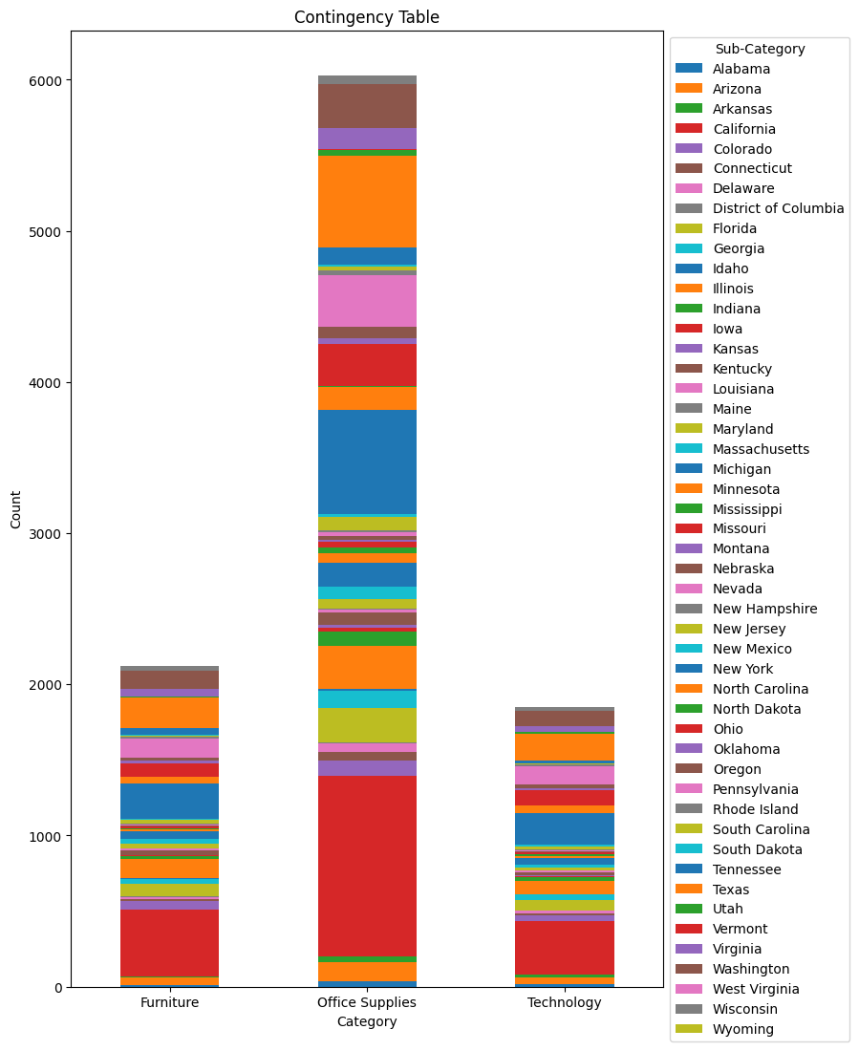
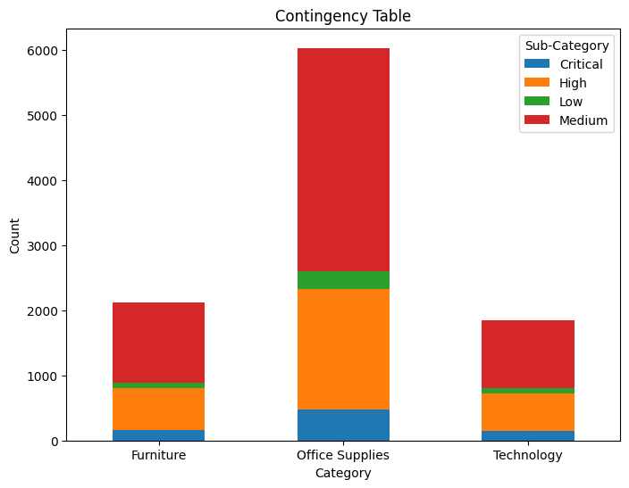
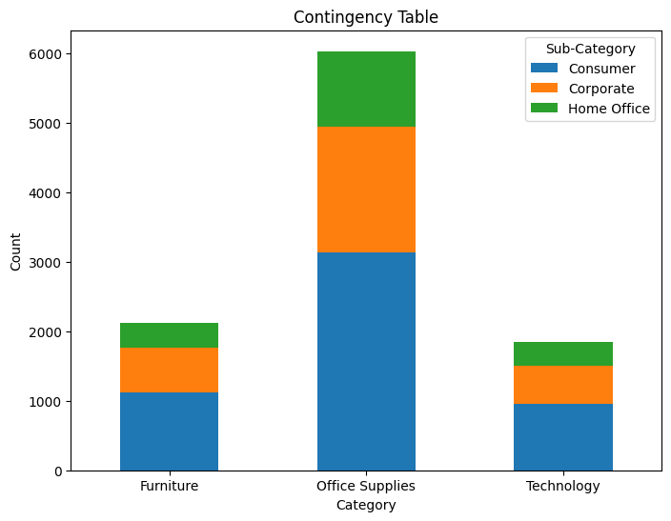
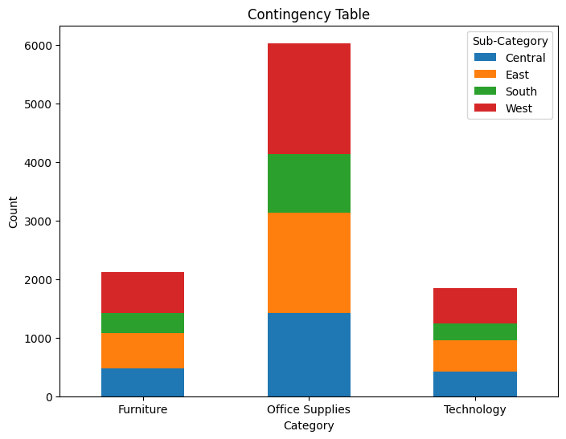
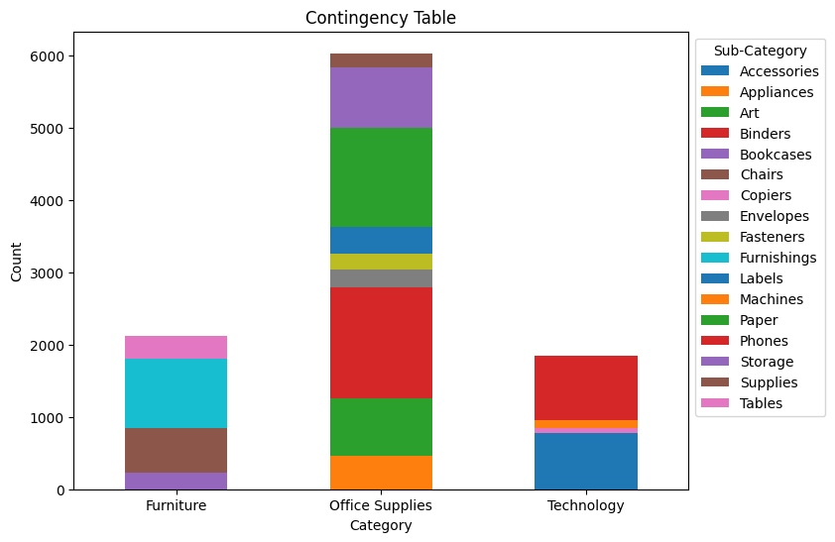
Results

Slide 12
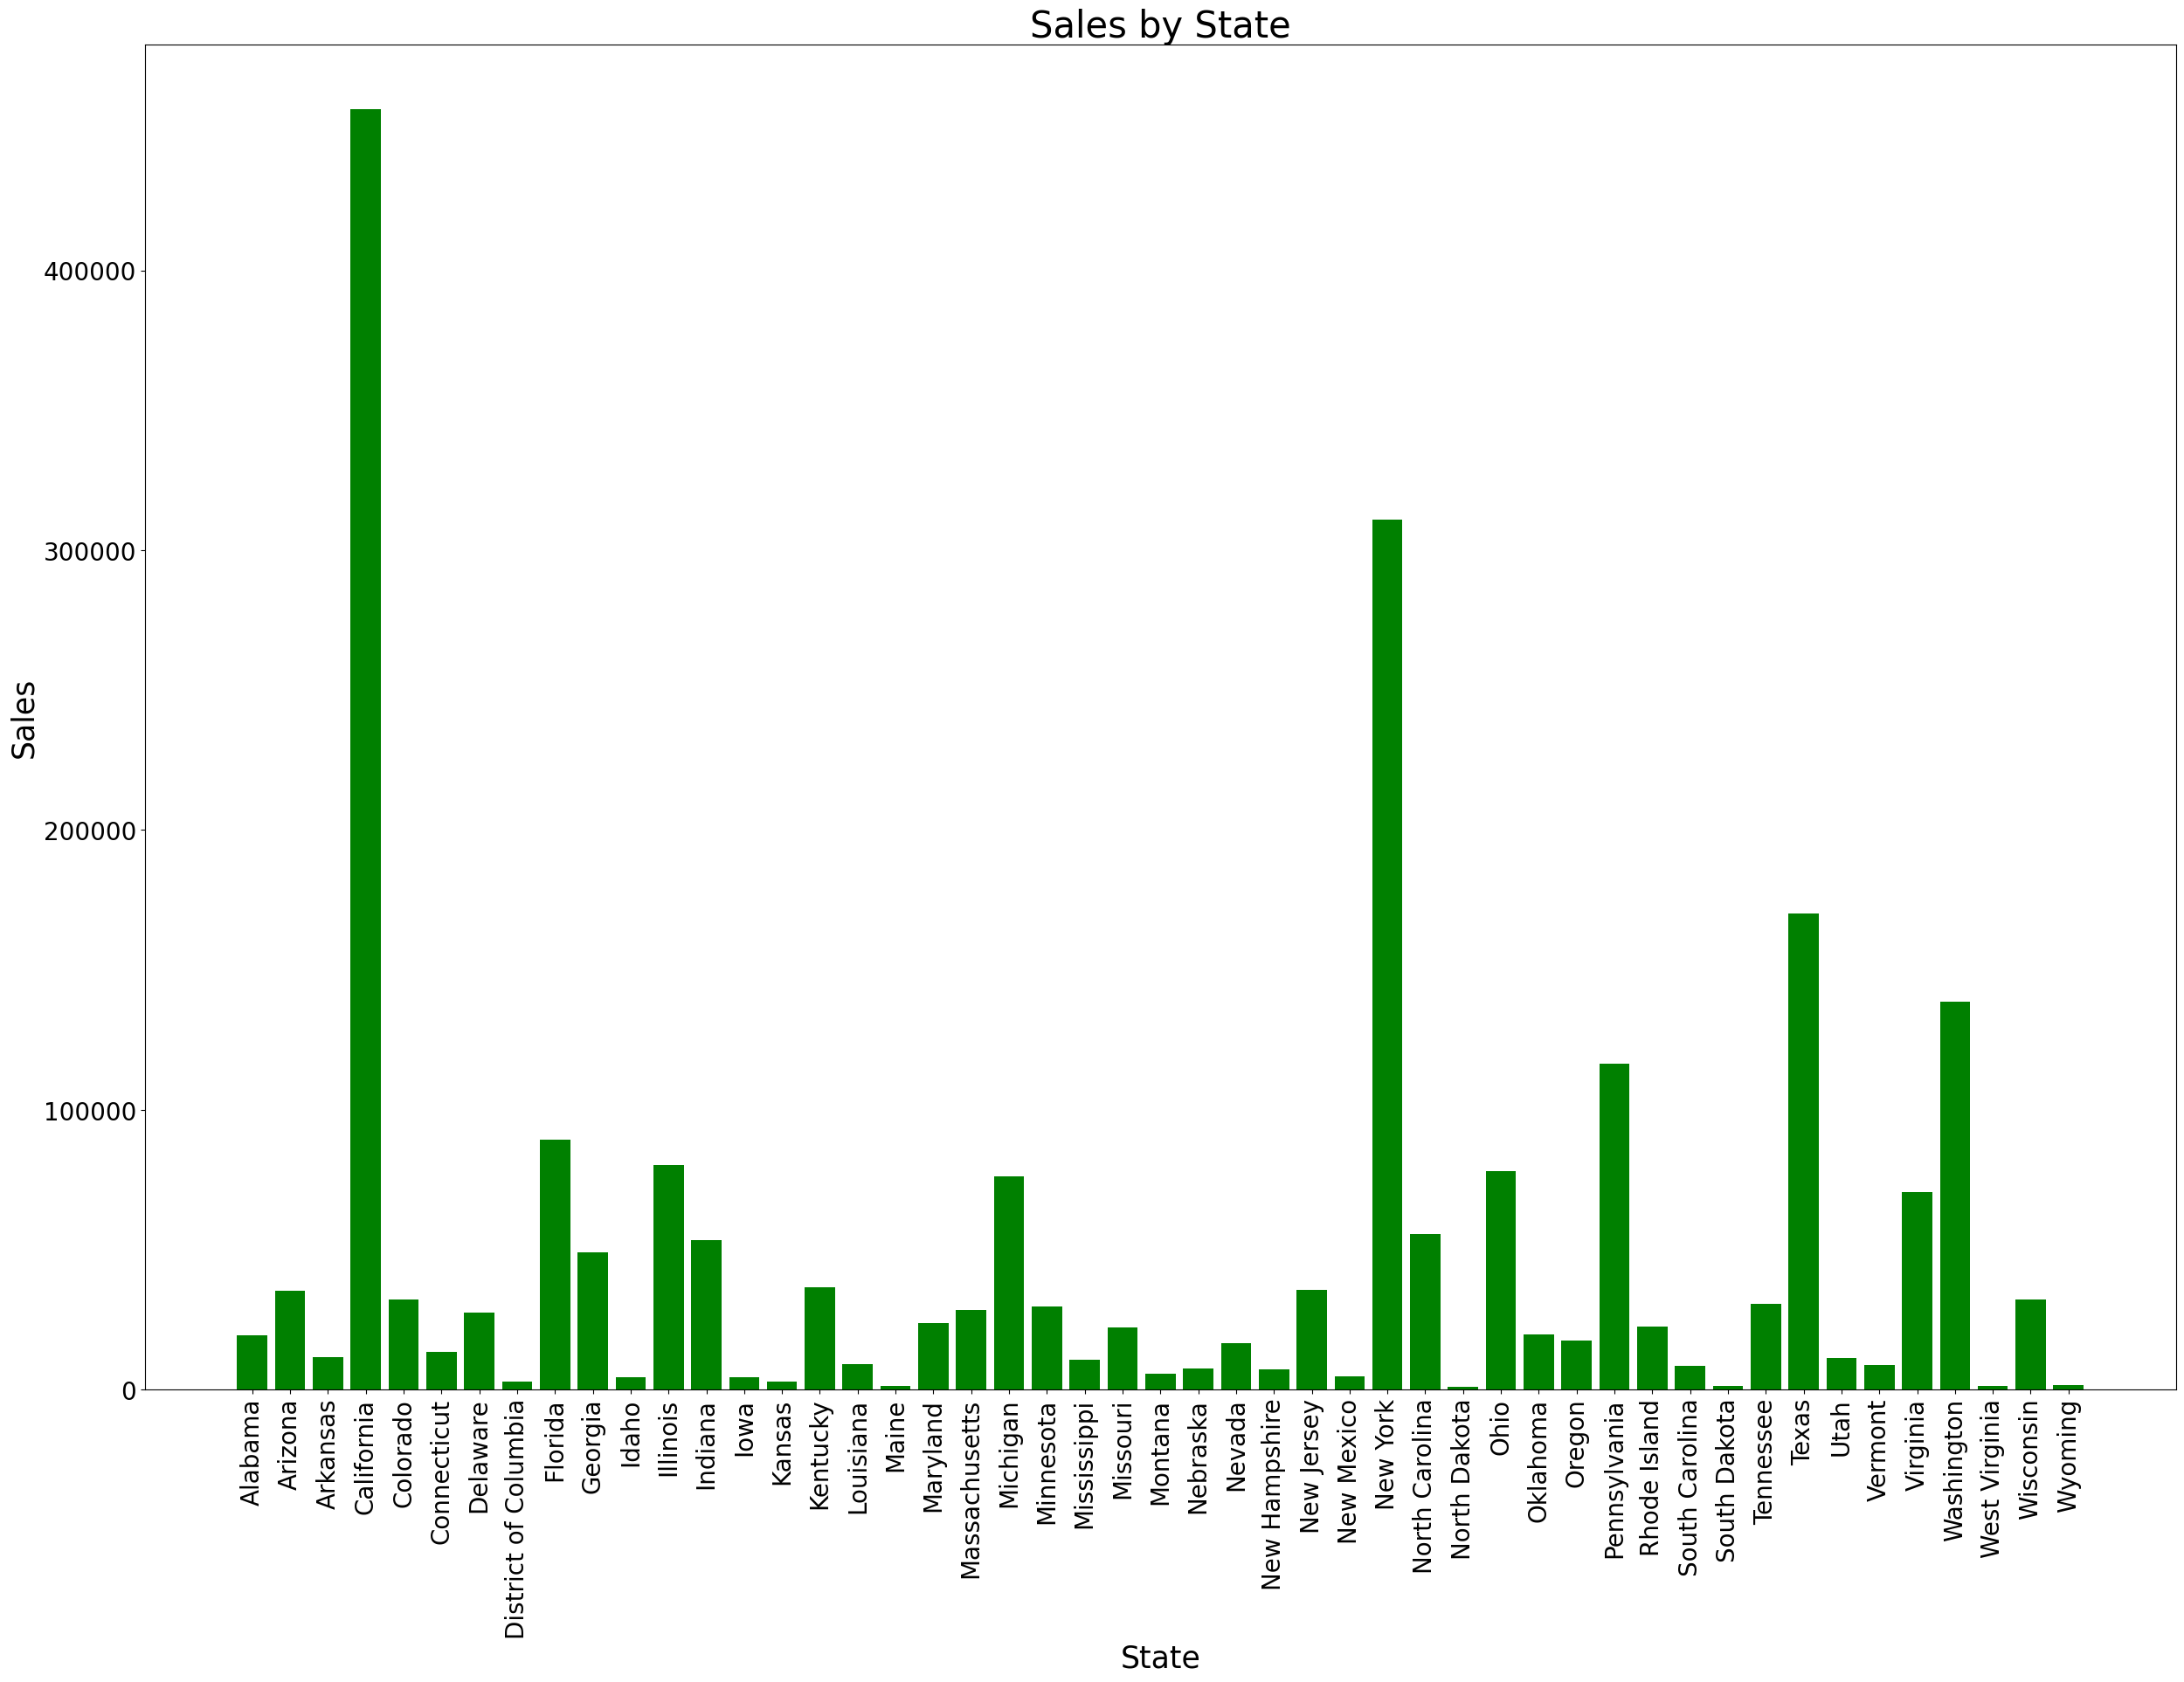
Results(sales by state)
The sales chart reveals a sequential pattern where California, followed by New York and Texas, emerges as the top three states in terms of sales.

Slide 13
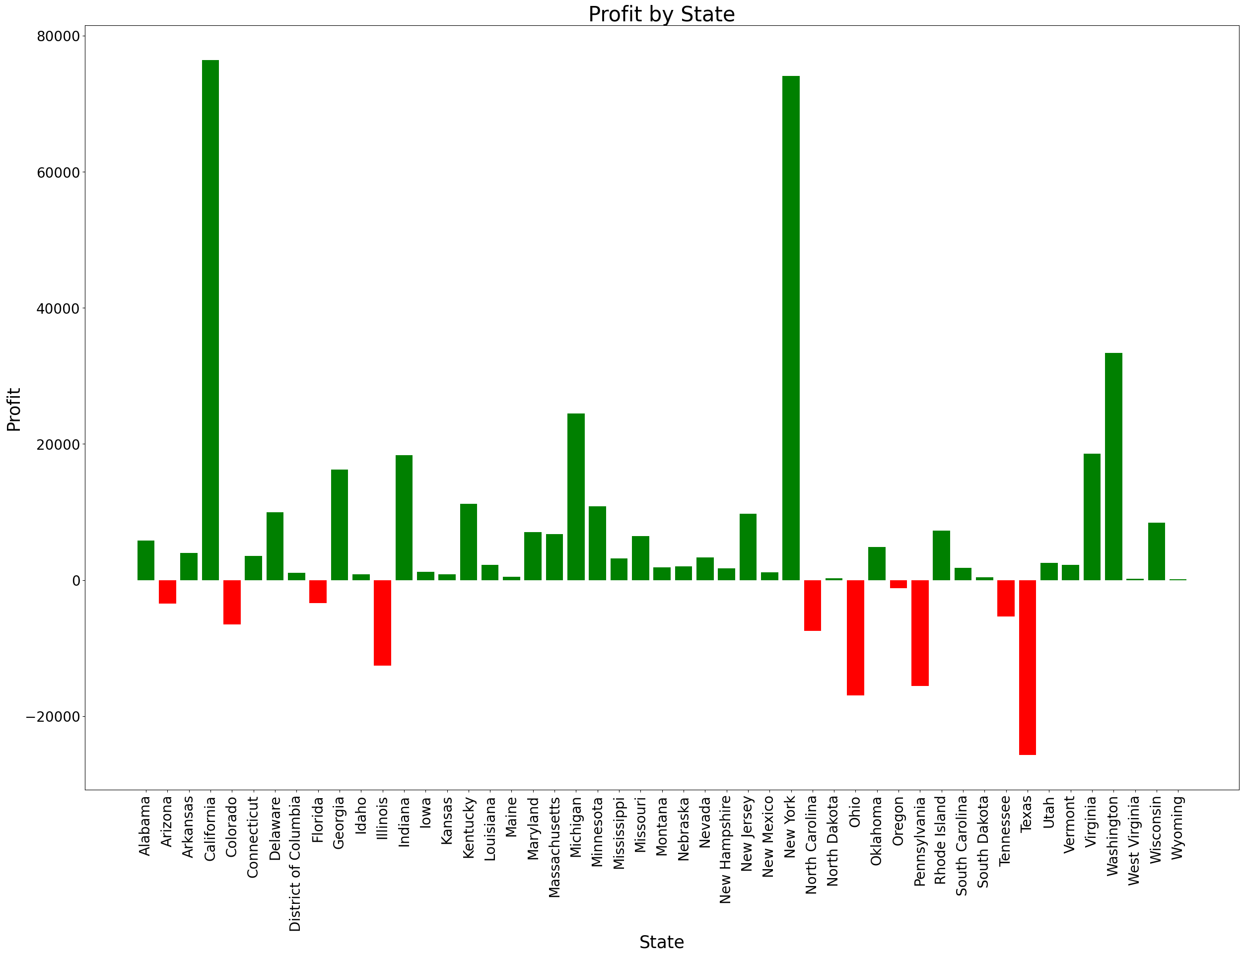
Results(profit by state)
Although Texas ranks third in terms of sales according to the sales chart, it is noteworthy that the state has encountered a financial loss compared to the lucrative profits generated by California and New York.
Based on the provided chart, it is evident that California and New York have generated significant profits, while Texas has experienced a notable loss in the analyzed period.

Slide 14
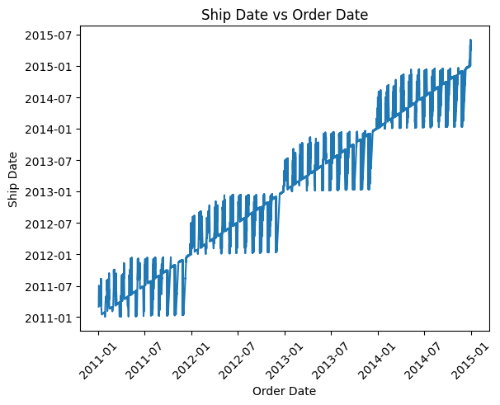
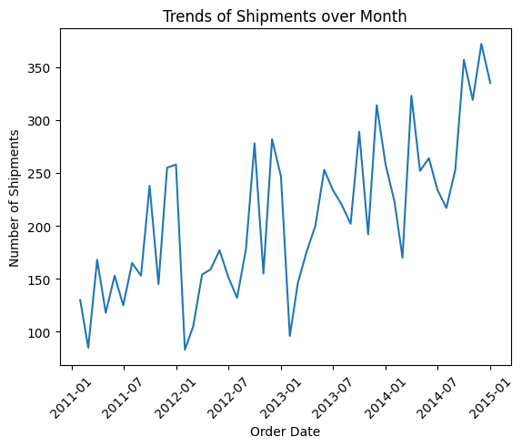
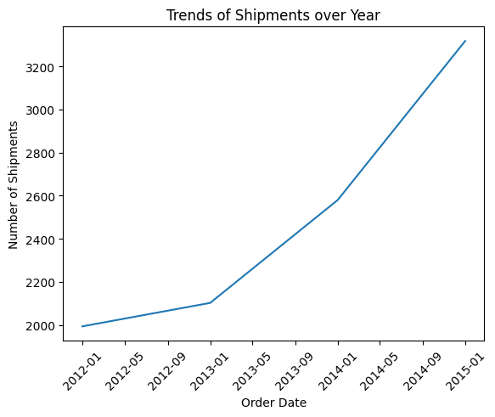
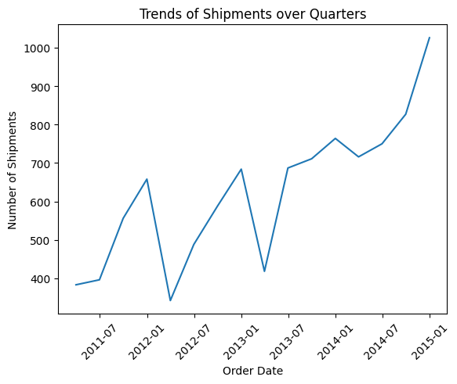
Results(based on time)
"Increasing over time, both shipping volumes and order quantities have witnessed a substantial rise, driving the need for efficient logistics and supply chain management."

Slide 15


links

